Slide 1

Audience Recognition

Slide 2
Audience Recognition
Who is your audience?
What does this reader or listener know?
What does this reader or listener not know?
What must you write or say to ensure that your audience understands your point?
How do you communicate to more than one person (multiple audiences)?
What is this person’s attitude toward your topic?
What diversity issues (gender, sexual orientation, cultural, multicultural) must you consider?

Slide 3
Successful Communication
To communicate successfully, you must
Recognize your audience’s level of understanding
Factor in your audience’s unique personality and traits

Slide 4
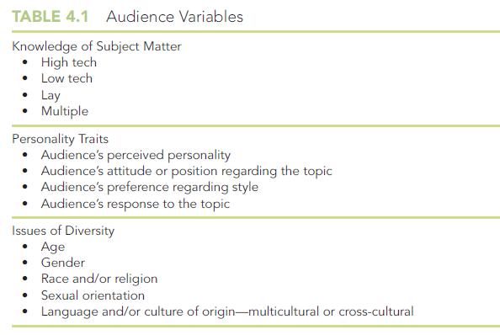
Audience Variables

Slide 5
Knowledge of Subject Matter
High-Tech Audience
Experts in the field you are writing about
Comparable: Share your level of understanding
Understand high-tech jargon, acronyms, abbreviations
An email message to a department colleague about a project
A letter to a vendor requesting specifications for a system she markets
Require minimal detail regarding procedures or scientific, mathematical or technical theories
Read to discover new technical knowledge
For updates regarding the status of a project
Need little background information regarding a project’s history
Or objectives unless the specific subject matter of the correspondence in new to them

Slide 6
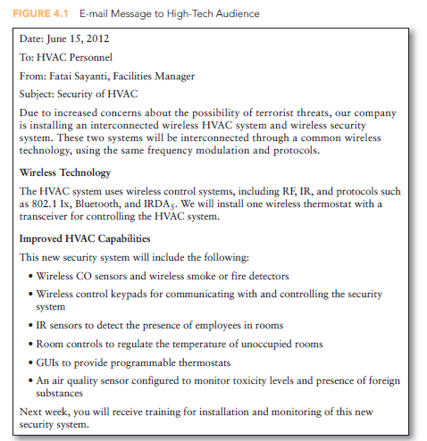
E-mail to High-Tech Audience
This e-mail is written to high-tech readers, uses terminologies without explanation or understanding. Its tone is businesslike and directive.

Slide 7
Knowledge of Subject Matter
Low-Tech Audience
Co-workers in other departments, your bosses, subordinates
Familiar with your subject matter, they understand some abbreviation, jargon and technical concepts, but for clarity define terms
BCA (Burst Cutting Area) is a circular section located near the center of a DVD disc where manufacturing information can be inscribed in a barcode.

Slide 8
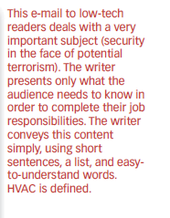
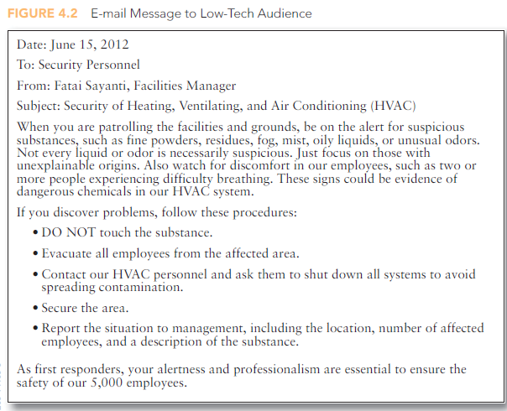

Slide 9
Knowledge of Subject Matter
Lay Audience
Don’t understand your in-house jargons, concepts, terms
Need background information
Customers and clients who neither work for your company nor have any knowledge about your field of expertise

Slide 10
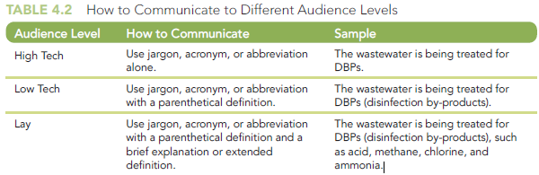
Knowledge of Subject Matter

Slide 11
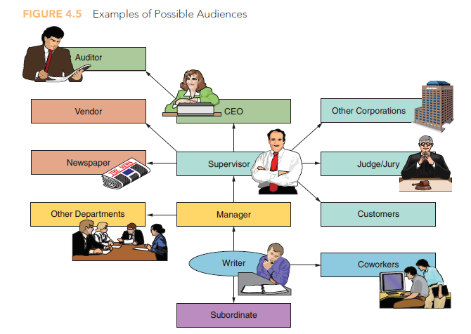
Knowledge of Subject Matter
Multiple Audience
High-tech, low-tech and lay

Slide 12

Knowledge of Subject Matter
Writing for Future Audiences
These readers could include
Judges and juries who depend on past reports to decide cases
New employees in a company who retrieve archived documents to learn how to complete current tasks
Accountants and auditors who look past records to find what work was accomplished at a prior date
New managers or supervisors who need to familiarize themselves with workplace procedures

Slide 13
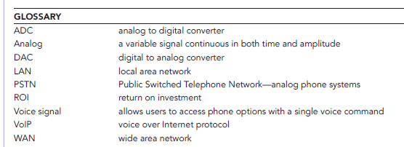

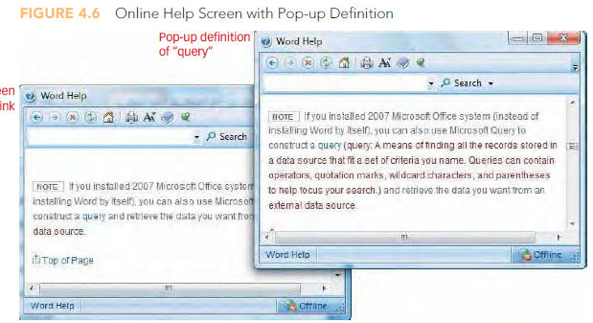
Define Terms for Audiences
Parenthetically
In a sentence
In an extended paragraph
In a glossary
As online help with a pop-up definition

Slide 14
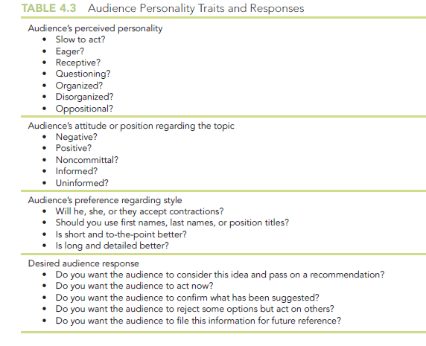
Audience Personality Traits

Slide 15
Issues of Diversity
It includes gender, race/ethnicity, religion, age, sexual orientation, class, physical and mental characteristics, language, family issues, departmental issues.
Why should you consider about a diverse audience?
Diversity is protected by the law
Respecting diversity is the right thing to do
Diversity is good for business
A diverse workforce keeps companies competitive

Slide 16

Any Questions?

